Slide 1
Newborn $creening (Budgets and Economics)
Leann Christensen, Fiscal Specialist
John D. Thompson, Director – Newborn Screening Program
Washington State Department of Health

Slide 2
Objectives
Current revenue and expenditures
Tools to assess costs
Look to reallocate money
Timeliness activities
Increase staff capacity
Caveat: WA experience – limited, but hopefully helpful

Slide 3
NBS Budget

Slide 4
Budgeting Basics
Notes:
2 major aspects of budgets

Slide 5
Revenue Sources
Notes:
Fee for service
Grants
State funds
Agency funds
Private foundations
Federal funds
Donations from community –some can be restricted to a certain item, some are for general use as see fit

Slide 6
Notes:
12% of dedicated is GFS

Slide 7
Notes:
On the contrary, here is how the NBS is funded.
Of the 98% local, 81% is fees

Slide 8
Newborn Screening Fee
$92.60 per baby*
$84.20 – NBS
$8.40 – Clinic Subsidy
Notes:
Two screen state that charges for 1st screen only (so we are charging per baby)– CLICK – cost is $92.60/baby
CLICK, CLICK
This charge just started 3/1, it was $84.50 ($76.10 NBS and $8.40 Clin Sub)

Slide 9
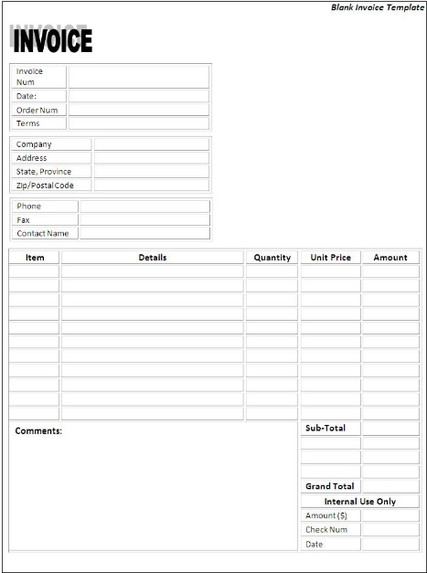
Billing
Facility Billing
96.25% of births
Access program to create invoices that are sent to hospitals/clinics
8-10 hours/month
Private Insurance Billing
3.75% of births
Collect insurance info
Third party biller submits claims because we do not have that expertise
16-20 hours/month
Notes:
Facility Billing = 96.25% Private Insurance

Slide 10
Private Insurance Billing Tip
WA State Health Care Authority is mandating Managed Care Organizations to contract with NBS!
50% of WA births are on a Medicaid Plan
Without this in place, we made $55,000 during the second half of 2017

Slide 11
Projected NBS Fee Revenue
Notes:
We use a biennium budget (2 year)
Projected by combination of research and internal knowledge
Our research is gathered from the Governer’s budget office – the state predicts the number of births each yr so we use their data
We do not use out of hospital births in our projections
EXCEL SPREADSHEET – Let’s take a look at the NBS fee budget

Slide 13
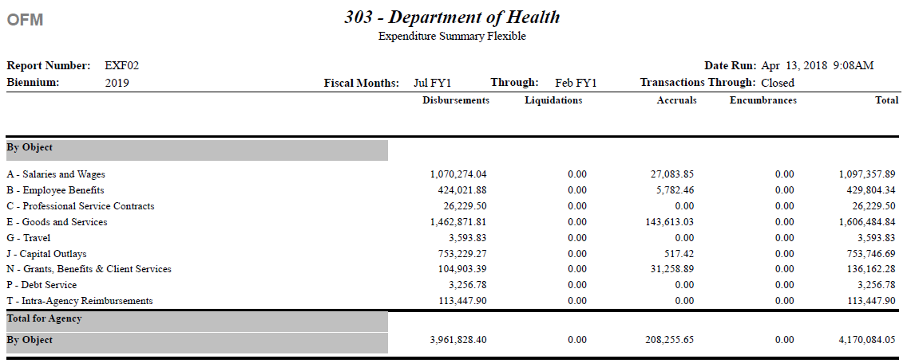

Slide 14
$aving Money by Reducing ¢osts

Slide 15
WA NBS Budget Team
Office Director
NBS financial specialist
Billing
Contracts management
PHL budget analyst
Budget support for five sections within Division
Other misc. support

Slide 16
Econ 101
Sunk costs
Money already spent – not working
Keep sinking money into effort
Cut losses
Opportunity costs
What are we choosing not to do/fund?
Public goods
Information on the internet (NewSTEPs 360 resources)
Technical assistance

Slide 17
Value of Monthly Budget Reviews
Monthly budget reviews
Keep a pulse on what’s happening
Plan for
COLAs/raises
Long-term plans
Good to have someone responsible for monitoring
bankruptcy example

Slide 18
Strategies to Keep the Ship Floating
Forecasting
Each year, costs increase
Kits/reagents
NBS collection cards
Service contracts (LIMS, etc.)
Take this into consideration when budgeting for a new test
Five-year estimate on costs
Estimate salaries on the high end - if turn-over, saves money
Prepare for a rainy day (i.e. birthrate lower than predicted, emergencies)

Slide 19
Ways to Save Money
Bundling
Purchasing in bulk
Maintenance contracts
Service contracts – several year agreement (with possible out)
Expensive equipment
Lease/purchase
Reagent/rental
Multiplexing
Technology
Robotics
IT solutions

Slide 20
Ways to Save on Personnel Costs
Part-time help
Overtime options
Vacancies save money

Slide 21
Audit
Beware of
“That’s how we’ve always done it.”
“That’s how I was trained.”
Process improvement
Process elimination?
Takes an initial investment before returns start coming
Value of fresh perspective

Slide 22
Free! (sort of)
Grant money
Allows for work that wouldn’t otherwise get done
Pays for work that would otherwise get done → frees up money for other things
Practicum/Internships
Synergistic opportunities for progress
Training
Microsoft academy/online resources
Donations

Slide 23
Getting More Money

Slide 24
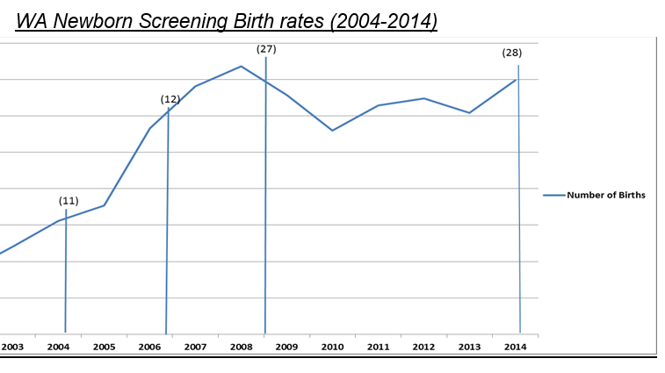
10 year cost analysis
Costs going up over time
Birthrates (9% increase)
Number of tests performed (145% increase)
Cost | increase
1. Avg. FTE salary & benefit | 42%
2. Facilities support cost/FTE | 69%
3. Key contractor costs | 44%
4. Postage | 15%
5. Equipment maintenance & repair | 200%
6. Supplies and reagents | 78%

Slide 25
Operational Fee Increase
Coordinated
Internal – upper management support
External – multidisciplinary NBS fee advisory board
Why?
Personnel – people working out of class
Aging instruments
Operating funds to keep up with inflation
WRAP
Workforce Resource Allocation Project

Slide 26
Budget Impact Analysis for Adding NBS for Pompe disease and MPS-I

Slide 27
New Test Costs
Instruments
Reagents and consumables
Buffers, wash solutions, testing plates, pipette tips, etc.
Staff time
Front-line lab technician
Lead worker
Follow-up staff
Indirects (23.7% - general agency support)

Slide 28
Calculating Cost/Test

Slide 29
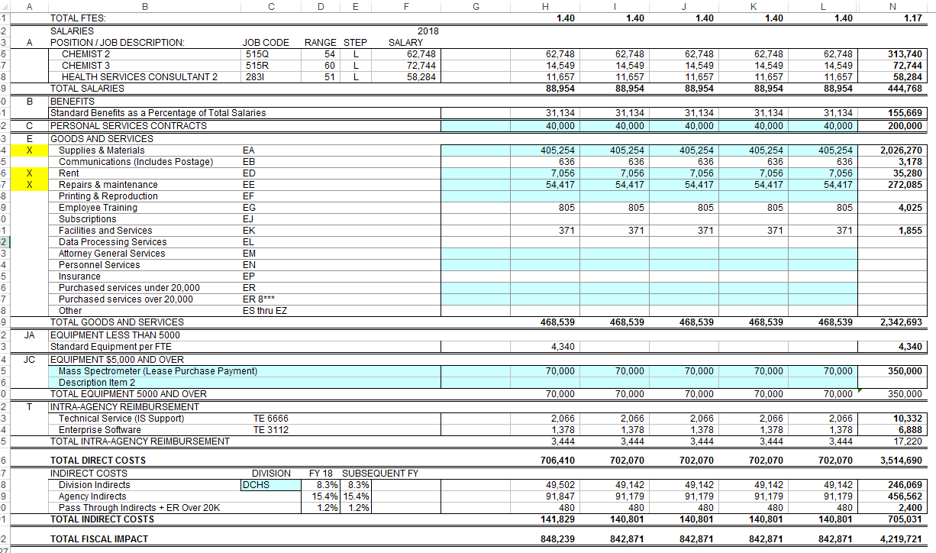
Financial Calculator
$848,239/90,000 = $9.42/baby

